Slide 1
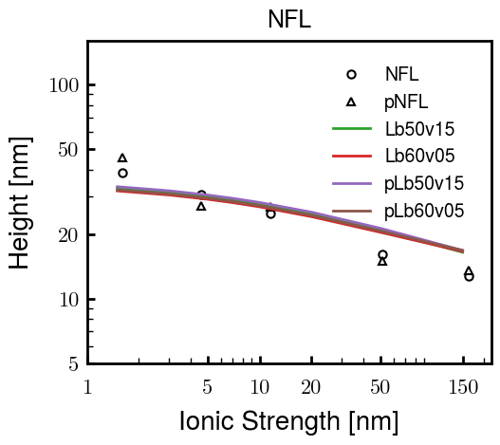
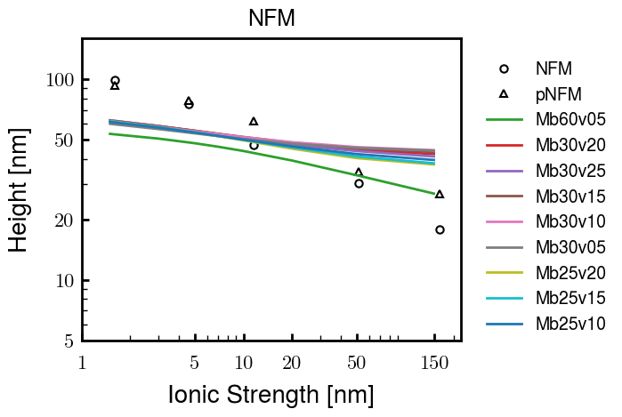
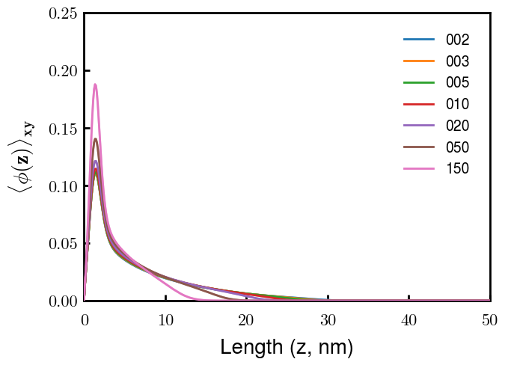
Note: disc N = 5, 6, 8 , 9 same for Mb30v25_NX

Slide 2





Slide 3
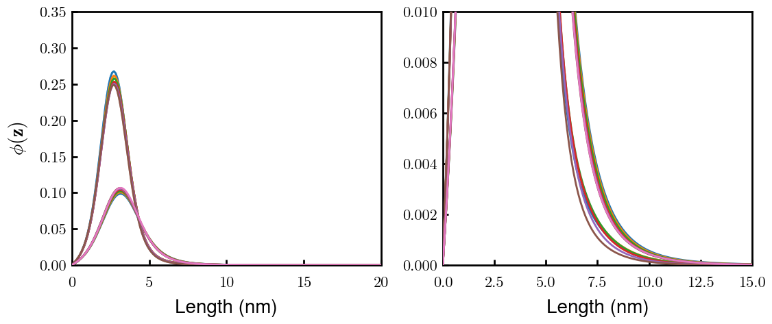
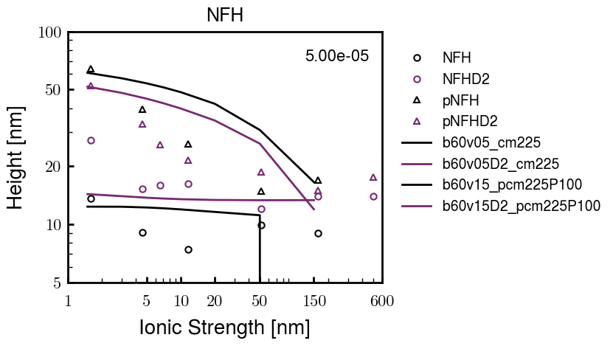
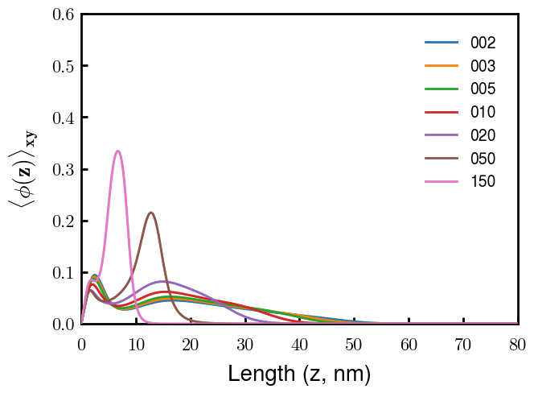
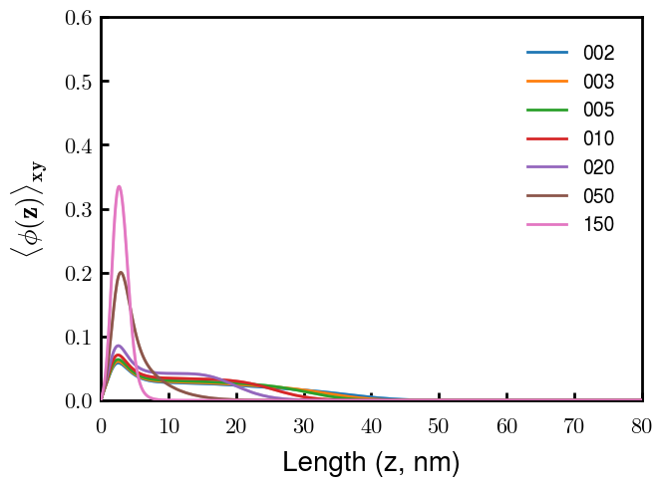
(p)NFH(D2)
NFH
NFHD2
pNFH
pNFHD2
(v = -1)
Points
v05 → v15 after phosphorylation
No condensed multilayer but worse fit

Slide 4
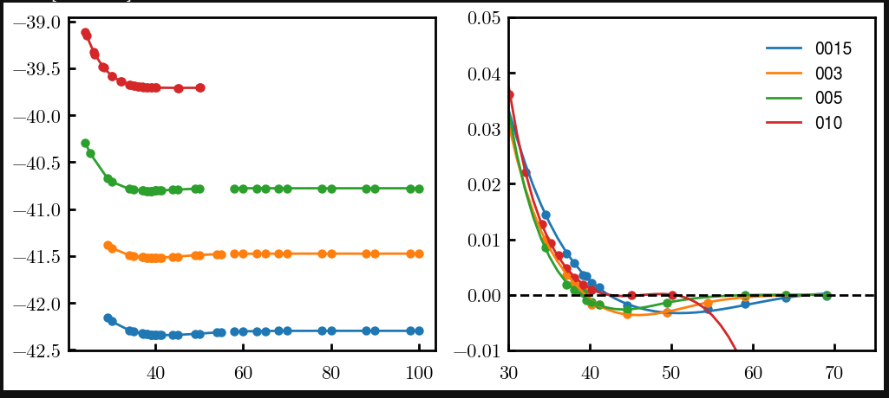
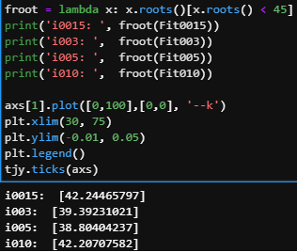
Try approaching surface

Slide 5




NFH (original); 31, 4
NFHD2; 40, 4
D2: delete 36-72
Rerun alg on D2
NFH (phos); 36, 4
NFHD2 (phos); 33, 4
Note: not currently doing this

Slide 6
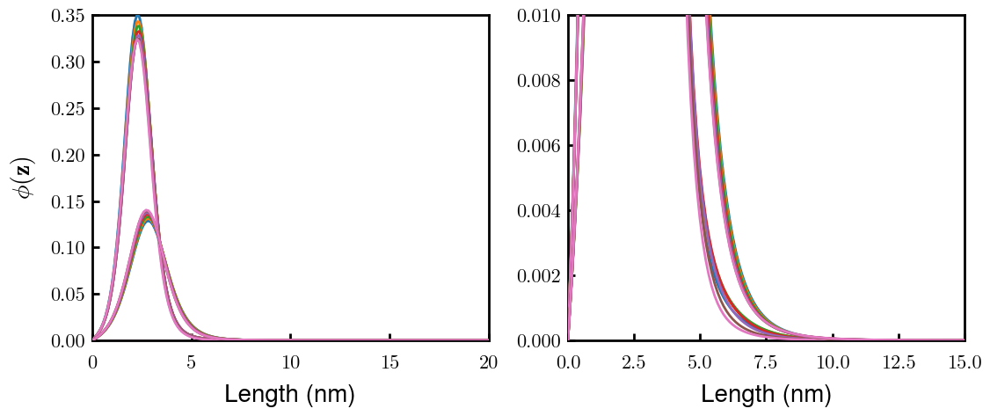
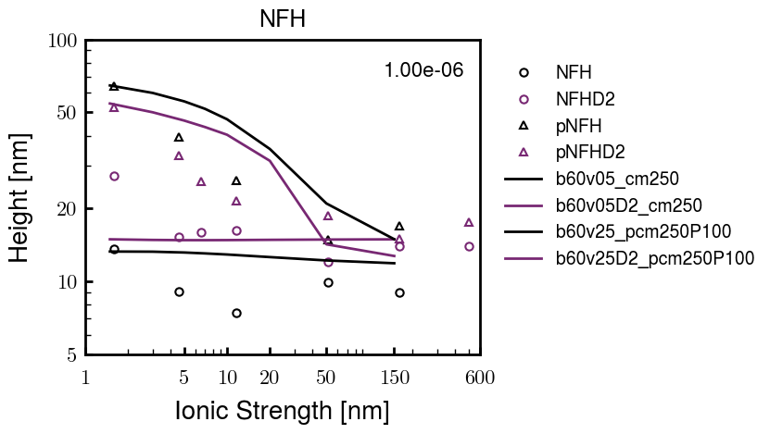
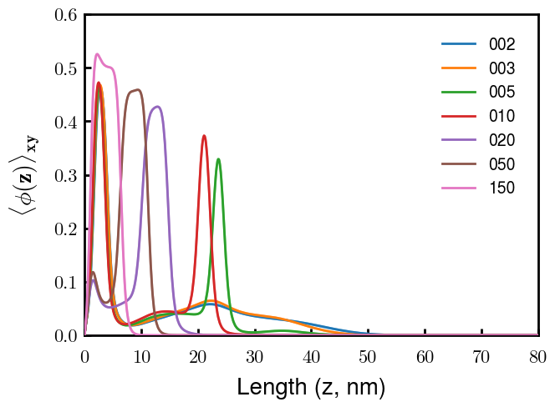
Best fit w/ consistent chi_max
NFH
NFHD2
pNFH
(v = -1)
Points
v05 → v25 after phosphorylation
Bilayer (trilayer for 5?) pNFH morphology

Slide 7
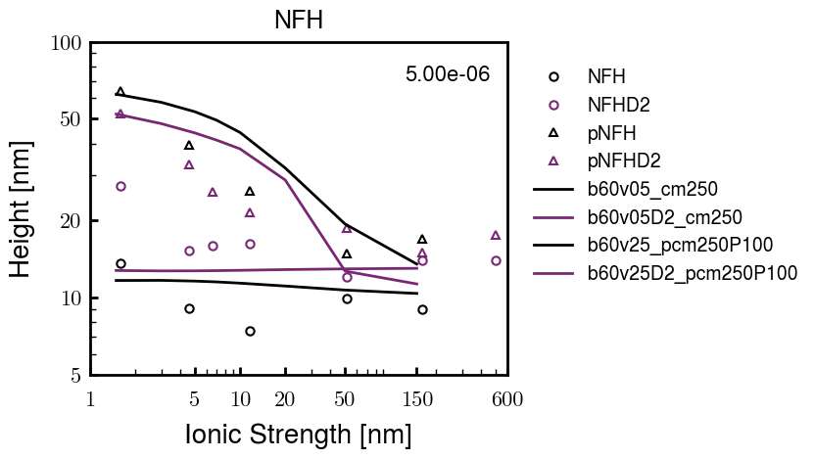
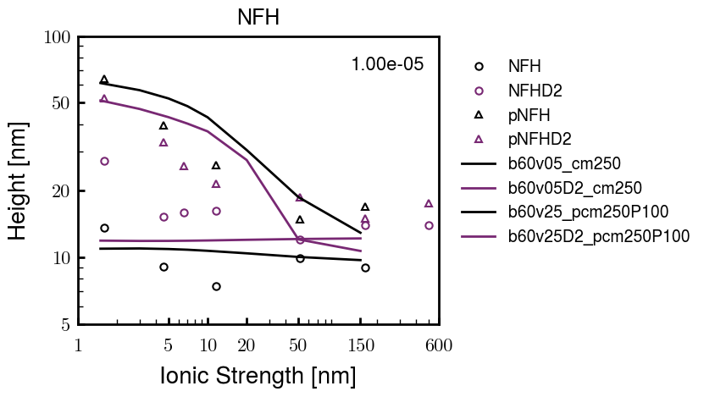
Same params as prev. w/ diff thresh

Slide 8
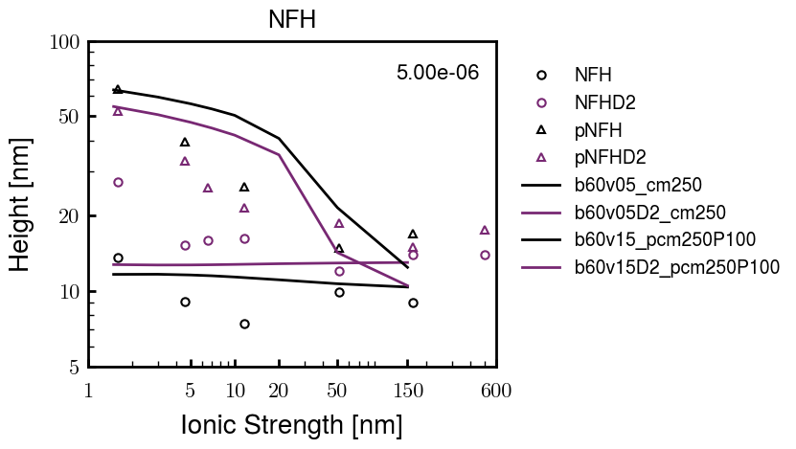
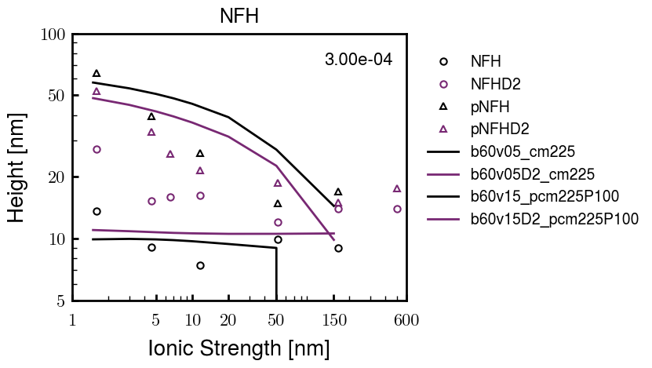
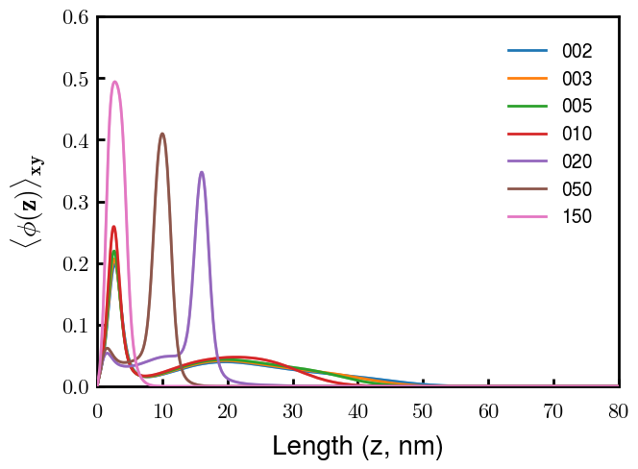
Find best without multilayer
pNFH
pNFH
(v = -1)
(v = -1)
Multilayer at 20

Slide 9
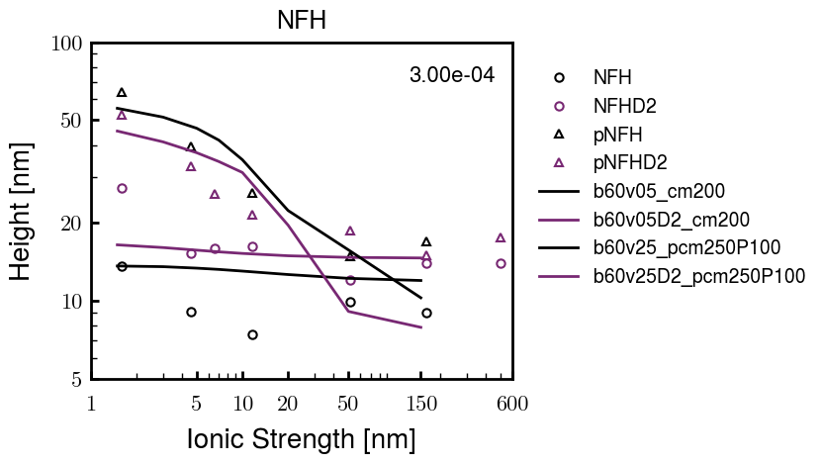
Best pNFH scaling fit (no regard to realistic)
pNFH
(v = -1)
Points
v05 → v25 after phosphorylation
cm200 → cm250 after phospho
Multilayer
Phospho < native

Slide 10






Native NFH

Slide 11







NFHD2

Slide 12




pNFH(D2)
4e-03

Slide 13





1e-06
4e-03
norm
4e-03
Try to bring pNFH down → {cmXX + PXX} only choice
norm
4e-03

Slide 14

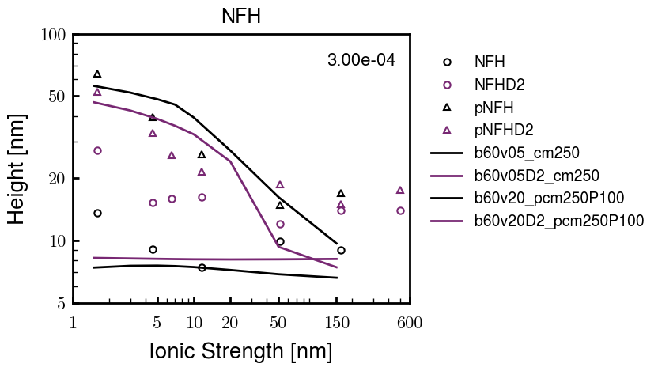


3e-04
3e-04
3e-04

Slide 15





Heights.params : b60v05 cm200
norm
1e-06
1e-05
1e-04
4e-03

Slide 16






Heights.params : b60v05 cm250
norm
ylog
norm
ylin
1e-06
1e-05
1e-04
5e-03

Slide 17




Heights.params: b60v10 cm{200, 225}
norm
1e-06
1e-05
1e-04
5e-03

Slide 18



Slide 19

 | Slope Bins 4 | Smear Count 25
Block number | Alpha w/ Henderson Hasselbalch | Chi Chi_max = 2.2
[0 50] | 0.040012 | 1.160000
[50 75] | -0.278451 | 0.720000
[75 125] | -0.519707 | 0.608000
[125 156] | -0.154453 | 0.529032

Slide 20

 | Slope Bins 4 | Smear Count 31
Block number | Alpha w/ Henderson Hasselbalch | Chi Chi_max = 2.2
[0 31] | 0.001103 | 0.922581
[31 62] | -0.386873 | 0.703226
[62 93] | -0.290146 | 0.967742
[93 496] | 0.037164 | 1.098759
[496 527] | -0.064533 | 0.819355
[527 620] | 0.010682 | 0.756989
[620 647] | -0.103326 | 0.696296

Slide 21






Previous
New

Slide 22





Slide 23


Response to stimuli given composition
Same data
Effect of composition given environment

Slide 24


NFL, pH 7.44, phos 1.5e (locs from LCMS)
Non-phos NFL
Block number | Alpha w/ Henderson Hasselbalch | Chi Chi_max = 3.2
[0 50] | 0.040012 | 1.540000
[50 75] | -0.278451 | 0.960000
[75 125] | -0.519707 | 0.868000
[125 156] | -0.154453 | 0.690323
 | Slope Bins 4 | Smear Count 25
Block number | Alpha w/ Henderson Hasselbalch | Chi Chi_max = 3.2
[0 50] | -0.019988 | 1.540000
[50 75] | -0.278451 | 0.960000
[75 125] | -0.519707 | 0.868000
[125 156] | -0.154453 | 0.690323

Slide 25

NFM, pH 7.44, phos 1.5e (locs from LCMS)
 | Slope Bins 4 | Smear Count 32
Block number | Alpha w/ Henderson Hasselbalch | Chi Chi_max = 3.0
[0 32] | 0.079143 | 1.275000
[32 64] | -0.186340 | 1.125000
[64 96] | -0.327964 | 1.181250
[96 160] | -0.460694 | 0.787500
[160 224] | -0.124999 | 1.115625
[224 288] | -0.023510 | 0.956250
[288 352] | -0.242085 | 1.003125
[352 384] | -0.031302 | 1.125000
[384 416] | -0.123860 | 1.050000
[416 438] | 0.046945 | 1.281818

Slide 26





Bin 3 NFM, pH 7.44, phos 1.5e (locs from LCMS)

Slide 27




Bin 5 NFM, pH 7.44, phos 1.5e (locs from LCMS)

Slide 28



Phos 2 NFM, pH 7.44, phos 2.0e (locs from LCMS)

Slide 29



Chi 2.5 NFM, pH 7.44, phos 2.0e (locs from LCMS)

Slide 30



NFM, pH 7.44, non-phos

Slide 31


NFH, pH 7.44, phos 1.5e (locs from LCMS)
 | Slope Bins 4 | Smear Count 36
Block number | Alpha w/ Henderson Hasselbalch | Chi Chi_max = 3.2 | Chi Chi_max = 3.0
[0 36] | 0.000945 | 1.266667 | 1.20000
[36 72] | -0.527455 | 0.900000 | 0.85000
[72 324] | -0.208376 | 1.729365 | 1.628571
[324 396] | -0.111195 | 1.416667 | 1.333333
[396 432] | -0.152824 | 1.344444 | 1.266667
[432 647] | -0.033955 | 1.077209 | 1.015814

Slide 32




Phos block dashed
Phos block dashed

Slide 33



Best are b3.0 v2.0 and b3.0 v3.0, but max H not high enough
Possible solutions:
Lower chi_max
Change aa_disc to have more charge
Force spectra?
Better for low salt, but high salt will melt brushes together

Slide 34



M1
pMx5

Slide 35



b3.00; v1, 2
b4.00; v2, 2.5, 3, 5, 10
b5.00; v3, 10, 15, 40
53 Nk
39 Nk
32 Nk

Slide 36
Binary results

Slide 37



Matrix Approach
Updated 04/04/2023

Slide 38














H Vol decrease (by v)
H Vol decrease (by b)
Desired “linearity” by tuning /thresh/ based on polymer density of expelled NFL
L Vol decrease (by b)
Comes at severe cost of overall height. Have to minimize outer concentration to approach pure thresh of 1e-06

Slide 39














H Vol decrease (by v)
H Vol decrease (by b)
Chimax 3.5
Desired “linearity” by tuning /thresh/ based on polymer density of expelled NFL
L Vol decrease (by b)
Comes at severe cost of overall height. Have to minimize outer concentration to approach pure thresh of 1e-06

Slide 40








F (3.5)
Chimax 3.5
Chimax 3.0
Scaled by 1.5
Scaled by 1.6
Scaled by 1.6
Scaled by 1.5
Scaled by 1.5
Scaled by 1.5
Scaled by 1.8
Scaled by 1.8

Slide 41
















Last test: same stiffness factor (b^3/v0) but with varying total volume

Slide 42












H Vol decrease (by v)
H Vol decrease (by b)
a2C_30
a2D_30
a2E_30
Rerun for Cs
b1C_30
b1D_30
b1E_30
L Vol decrease (by b)
a1C_30
a1D_30
a1E_30
g1C_30
g1D_30
g1E_30
Rerun for Cs

Slide 43












H Vol decrease (by v)
H Vol decrease (by b)
a2C
a2D
a2E
b1C
b1D
b1E
Block 4 (NFL end)
L Vol decrease (by b)
a1C
a1D
a1E
g1C
g1D
g1E

Slide 44









H Vol decrease (by v)
Chimax 3.5
H Vol decrease (by b)
a2C_30
a2D_30
a2E_30
b1C_30
b1D_30
b1E_30
L Vol decrease (by b)
a1C_30
a1D_30
a1E_30
g1C_30
g1D_30
g1E_30

Slide 45







For i as L and H:
Pure height profiles
Mixed height profiles
Current L library
Current H library
Skip; marginal increase in vol prob not enough
Move onto chi3.0; larger NFL vol library

Slide 46





NFL
All plotting wrong L pure; look only at purp
NFH
H volume too low to neutralize L (v = 31 nm3/c)

Slide 47







H volume v = 60 nm3/c

Slide 48







H volume too low to neutralize L

Slide 49










NFH, V = 70
L30

Slide 50





NFH & NFL v = 0.15
a2D
b1D
g1D

Slide 51





Based on NFH b5v15c3, apply VL = VH
NFL and NFH are from same amino acids but diff chain lengths. Should VL = VH?
L30 / H70
L80 / H20
L30 / H70
L80 / H20

Slide 52






L30 / H70
L80 / H20
L30 / H70
L80 / H20

Slide 53
L Fitting

Slide 54


VL = VH

Slide 55







Try b change, v same as H (0.15)
Phi unrealistic (?)
Phi unrealistic
Phi very unrealistic
Phi very unrealistic

Slide 56






Try similar params to H
5.6
11.2
16.8
28
56
7.5
11.25
18.75

Slide 57







Try similar params to H, b0.36
7.8
15.6
23.4
31.2
Unrealistic vol
Not very sensitive to v; not high enough to intersect neighboring chains (function of b and sigma)

Slide 58


Continuation from prev params

Slide 59







v2.7 and some fine
b1.50 v2.7 c3.2
b1.75 v2.7 c3.2
b1.75 v2.5 c3.2
b1.75 v2.5 c3.0
b2.0 v2.7 c3.2
b2.25 v2.7 c3.2
b2.50 v2.7 c3.2
Phi too small to decrease v0

Slide 60










b2.0 v10.0 c3.0
b2.0 v8.0 c3.0
b2.0 v6.0 c3.0
b2.0 v4.0 c3.0
b2.0 v2.0 c3.0
Phi limit
b1.8 v10.0 c3.0
b1.8 v8.0 c3.0
b1.8 v6.0 c3.0
b1.8 v3.0 c3.0
b1.8 v2.0 c3.0
Phi limit

Slide 61





b1.6 v10.0 c3.0
b1.6 v8.0 c3.0
b1.6 v6.0 c3.0
b1.6 v2.0 c3.0
b1.6 v1.5 c3.0
Phi limit

Slide 62









b2.0 v2.7 c3.2
b3.0 v3.5 c3.5
b3.0 v7.0 c3.5
b3.0 v7.0 c3.0
Phi too small
Phi too small to decrease v0
b4.0 v12.0 c3.0
b5.0 v20.0 c3.0
b5.0 v20.0 c4.0
b5.0 v5.0 c3.0
b5.0 v10.0 c3.0
Phi too small to decrease v0

Slide 63





v20
b5.0 v20.0 c3.0
b4.5 v20.0 c3.0
b4.0 v20.0 c3.0
b3.5 v20.0 c3.0
v10
b5.0 v10.0 c3.0
b4.0 v10.0 c3.0
b3.0 v10.0 c3.0
b2.0 v10.0 c3.0

Slide 64




b2.00 v2.70 c3.20
b2.00 v2.75 c3.20

Slide 65
NFH fitting (from NFL best fit)

Slide 66








b1.00, v0.50, c3.2
b2.00, v4.00, c3.2, th2.5e-02
b1.00, v2.00, c3.2
b1.00, v1.00, c3.2

Slide 67
Mixture

Slide 68



Slide 69


b = 0.75

Slide 70





Slide 71
b = 1.0

Slide 72





Slide 73
b = 1.25

Slide 74




Chi 2.6
Bad vol frac

Slide 75








b25v0
b25v1
b25v2
b25v3

Slide 76




Chi 2.8
Bad vol frac

Slide 77





Slide 78
b = 1.50

Slide 79






Chi 2.8
Bad vol frac

Slide 80





Slide 81

b = 2.00
v4 = 0.25*b^3

Slide 82


Bad vol frac

Slide 83



Slide 84
Fine tune

Slide 85



b1.25, v1.95, c3.0
b1.50, v3.38, c3.0
b2.00, v4.00, c3.0
Norm seems to capture kinked behavior

Slide 86




Slide 87



b1.25, v1.95, c3.2
b1.50, v3.38, c3.2
b2.00, v4.00, c3.2

Slide 88




Slide 89


b1.25
b1.50
b2.00
c2.8
c3.0
c3.2

